Slide 1
Aerial photographs
TYPES

Slide 2
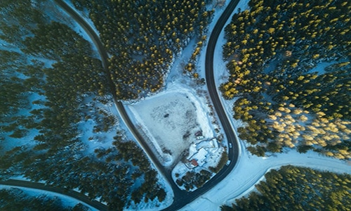

Slide 3
Aerial photography refers to the taking of photographs from an elevated position. Usually, the photographs are taken from some air- borne craft or equipment such as rockets, airplanes, hot air balloons and drones.
For a photograph to qualify as an aerial photograph, it must be taken using equipment that its base is not on the ground. There are many categories of aerial photography, usually categorised according to the angle of taking a photograph.

Slide 4
Aerial photographs are also categorised according to the proximity and width of the area covered in the photograph about the subject of the photography.
As such, there are oblique, vertical, high, low, wide or close- up aerial photographs.a It is possible for a single photograph to fall into two or three such categories. Hence, you can have an oblique photograph that is flat and wide at the same time.

Slide 5
VERTICAL AIR PHOTOGRAPH
Vertical air photograph A photograph taken from the air with the optical axis of the camera perpendicular to the surface of the earth. Vertical photographs have practically a constant scale and are used to prepare maps and detect camouflaged objects

Slide 6
TRUE VERTICAL PHOTOGRAPHS
Unlike oblique photographs, vertical photographs are those that are taken directly from the object to be captured.

Slide 7
OBLIQUE PHOTOGRAPHS
Oblique photographs are those that are taken at an angle. These can either be wide or close-up, and high or low.

Slide 8
THE OBLIQUE AERIAL PHOTOGRAPHY
can show the exact same thing that the vertical aerial photography shows, but the angle is sloped with the camera axis pointing north-east, south-east, south-west, north-west… you get the drift.
The intention is to create a more dramatic photography of the area and for viewers to easily comprehend the location. It is also useful for looking at foreground building frontages. Features in the background, however, could not be recognized because they are either too small or hidden by the features in front.

Slide 9
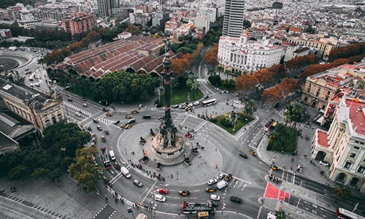

Slide 10
